Slide 1
Dating Go
Brandon Maweu, Yukyeong Ko, Daniel Bae, Elias Khan, Kylie Quinney, Ayush Sharma, Anthony Vu, Alan Nguyen

Slide 2
Overview
Objective
Sequence Diagram
Cost Estimation
Class Diagram
Project Timeline
Architectural Design
Functional Requirements
Demo of User Interface Design
Non-Functional Requirements
Use Case Diagram

Slide 3
Objective
Design a unique dating app unlike any others currently on the market
The interface of the app will be similar to the mobile game ‘Pokemon Go’ with interactions/dating aspects similar to ‘Tinder’
‘DatingGo’ aims to combine elements from both apps mentioned above and encourage in-person mingling in public areas where interested individuals in the same area are given the ability to connect.

Slide 4
Cost Estimation
Total estimated cost of additional software is $1830
Intellij IDEA - $600 per developer (3*600 = 1800)
Design tool - $30 per developer (3*10 = 30)
Estimated cost of additional hardware
Dell PowerEdge R450 (On-premise set up fee): $3,089
AWS EC2 c5.4xlarge (On-demand cloud server): $496.40/month
Total estimated cost for personnel is $4650
This includes laptop and training cost per developer.
The total estimated cost for our entire project is $22,215
The cost to developer our software is $10,125.
Maintenance of our software costs $2025.
The total cost is the sum of all of our estimates.

Slide 5
Project Timeline
Start Date: May 13th 2024
End Date: May 24th 2024
Team Size: 3 people
Based On: 5 day work week (Monday-Friday), 8 hr days
Total of 10 work days to complete the project (1.5 weeks)

Slide 6


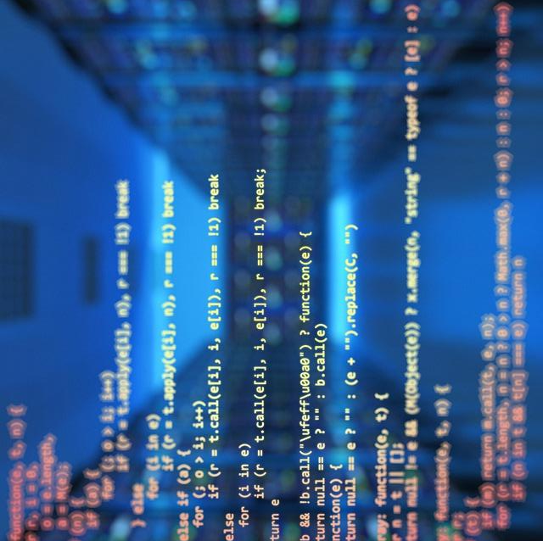
Functional Requirements
Creating Profiles
Setting Mingling Status
Viewing Potential Matches
Compatibility Score
Sending Mingling Requests

Slide 7
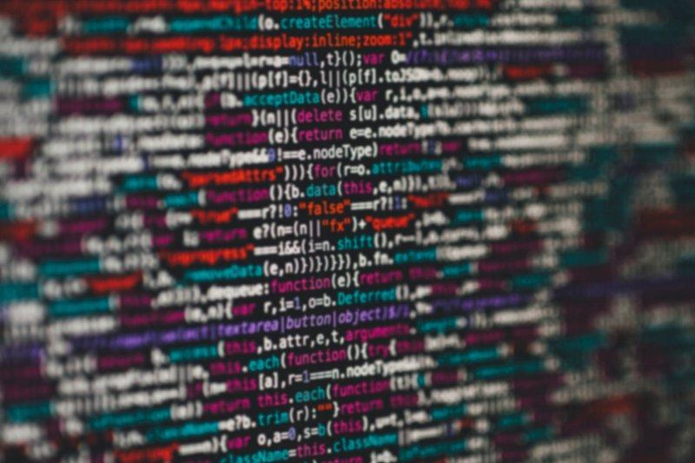
Non-Functional Requirements
The app will run on both IOS and Android devices.
The servers should have an uptime of 98%.
There should be different geographical servers to balance all the proximal concurrent users and their requests.
The app will follow data privacy and protection laws that require users to be informed how the app collects and utilizes their data as soon as they download the app.
All network traffic should be sent over HTTPS so that it is encrypted.

Slide 8
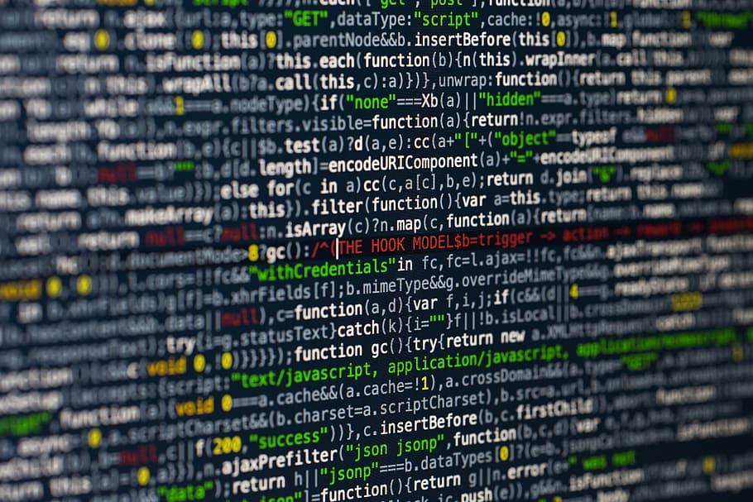
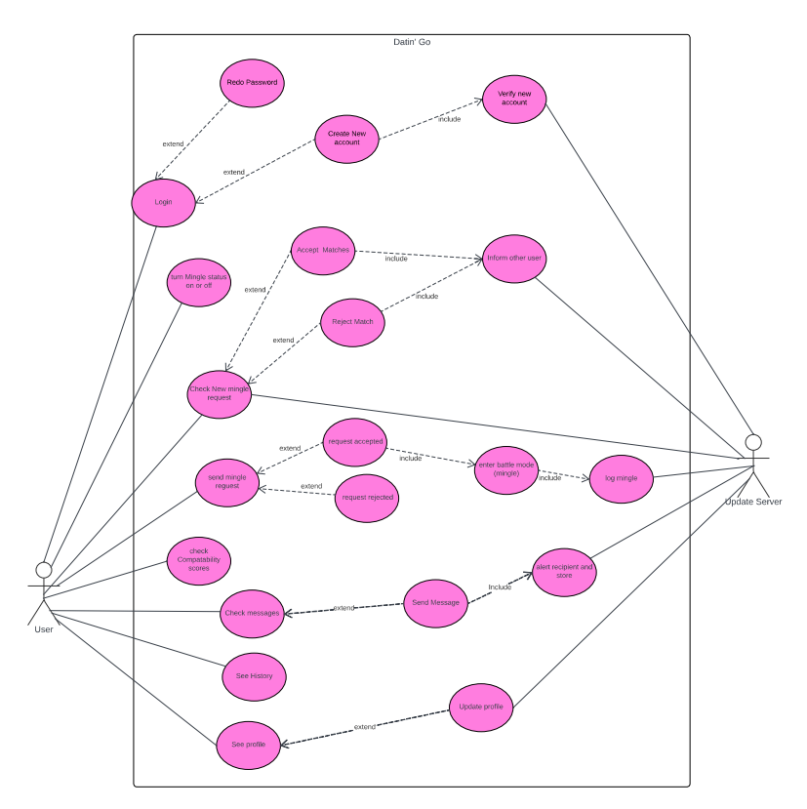
Use Case Diagram
Use Case Diagram: shows interactions between server and client.

Slide 9
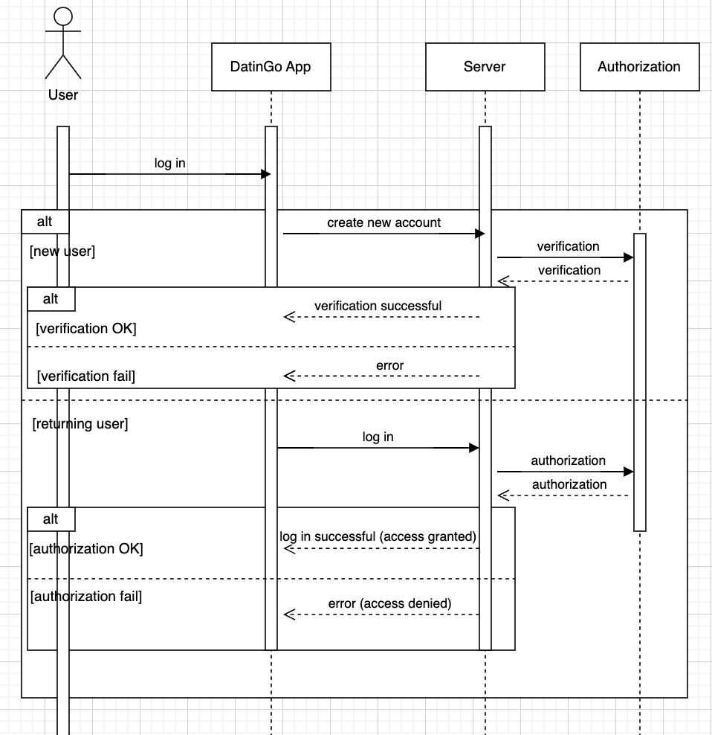
Sequence Diagram
Operation of program: User logs in

Slide 10
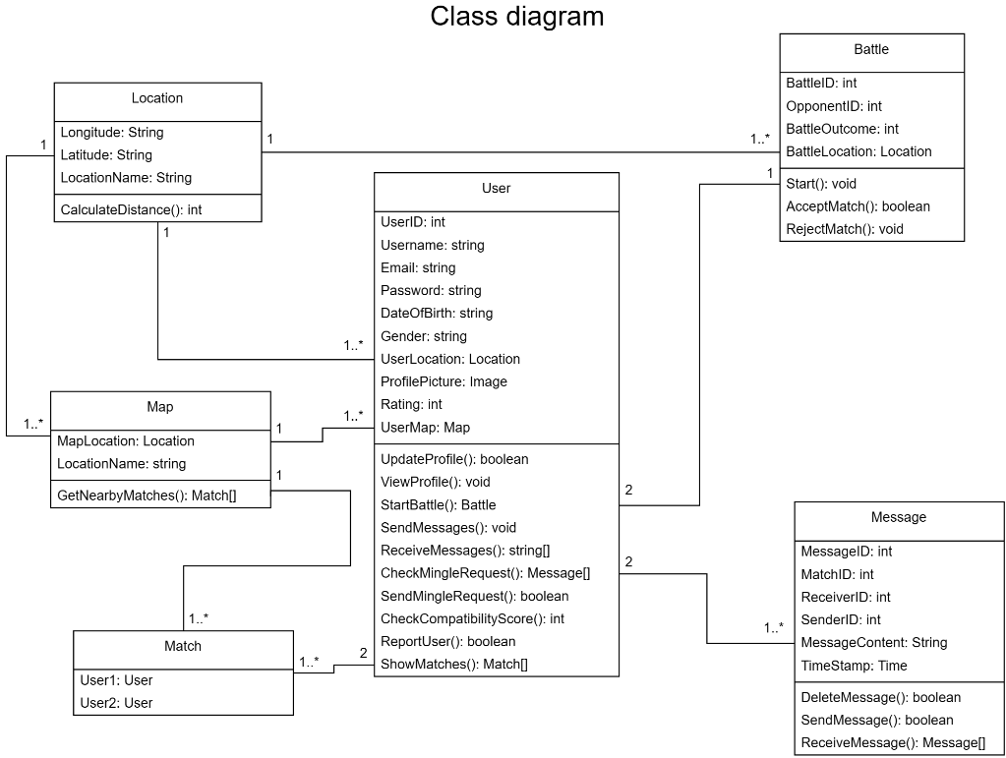
Class Diagram
User handles all profile functionalities for our users.
Messages handles functionalities regarding messages between users.
Location handles geolocation functionalities while Map handles finding nearby users.
Match handles functionalities of matching two users together.
Battle handles battle system for matches.

Slide 11
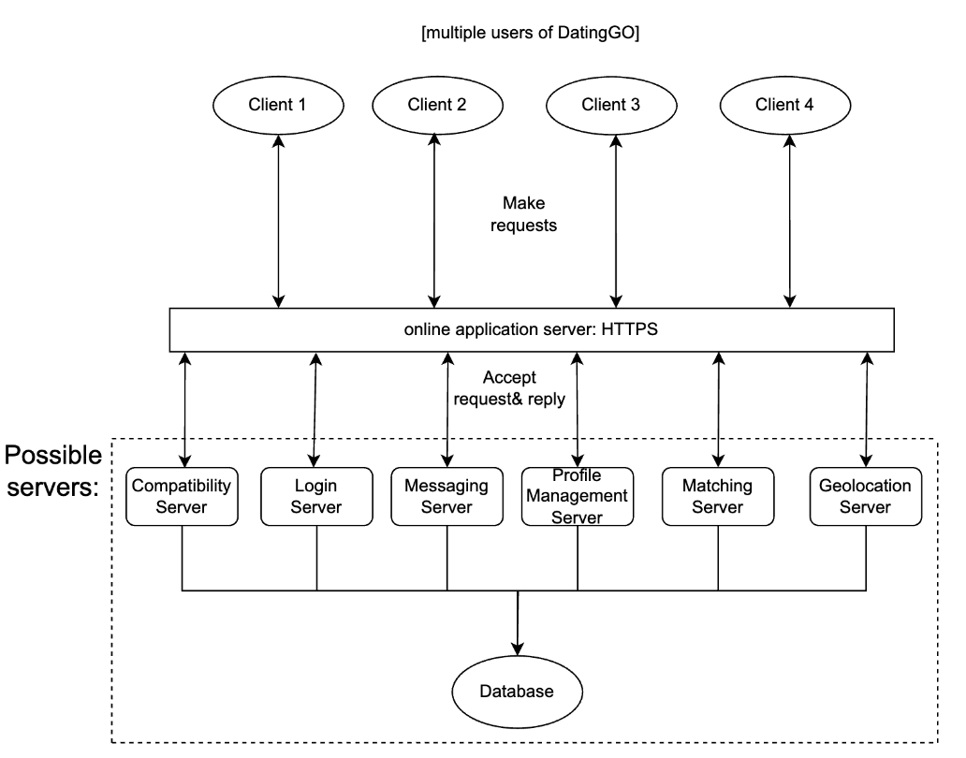
Architectural Design: Client-Server
Allows for functionality to be organized in services.
Splitting of workload between entities
Centralized Management and data security and authentication were a priority.
Scalability into the future.

Slide 12
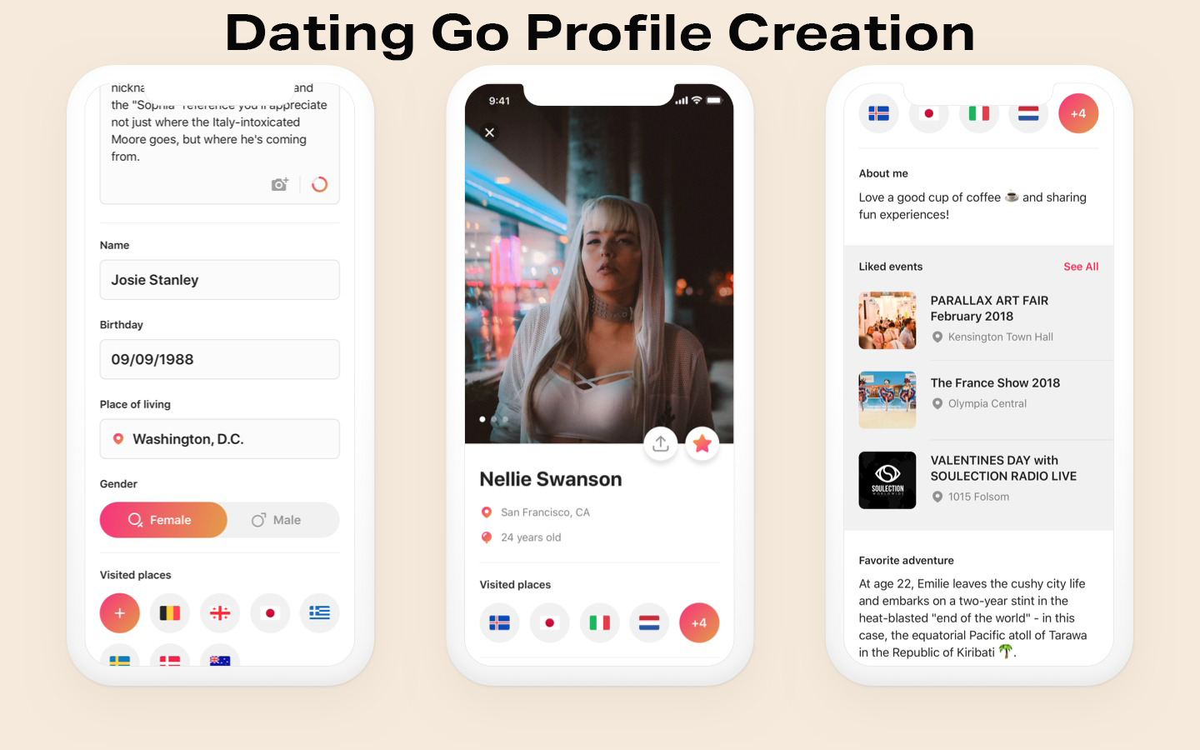
Demo of User Interface Design

Slide 13
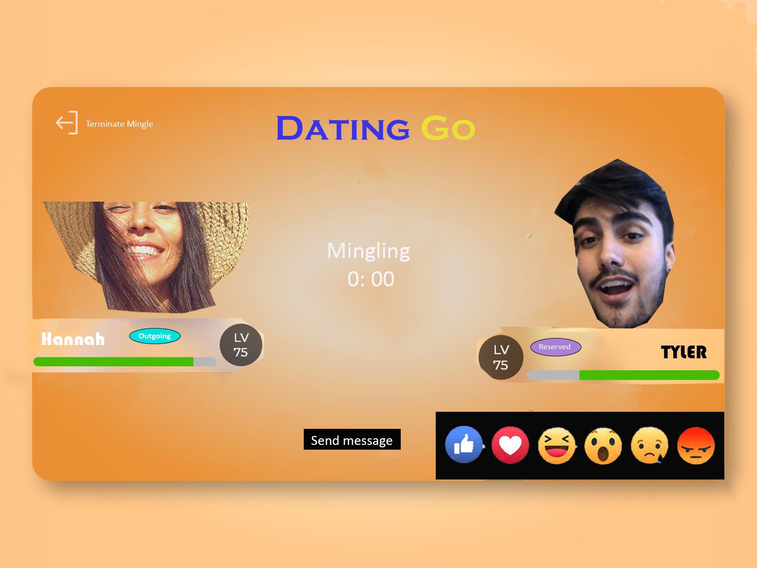
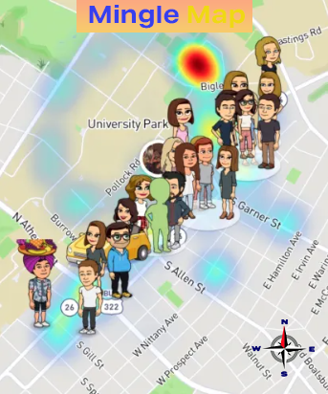
Demo of User Interface Design

Slide 14
Conclusion
Original Vision: Pokémon GO-inspired Dating App to create a unique, engaging dating experience.
Goal: Encourage users to explore new places, meet new people, and form connections in a playful environment.
Matching System: - Displays potential matches based on geographical proximity and compatibility. - Options to hide mingling status and location to respect user privacy.
Adjustments and Deviations: - Some features were scaled back due to budget and technical limitations. - Focus shifted to core functionalities to ensure user experience and privacy. - Adjustments align with user feedback, emphasizing a balance between engaging game elements and practical dating features.

